Slide 1


#1 Chess Engine of Spring 2017 at S&T
Made by Shawn Roach

Slide 2
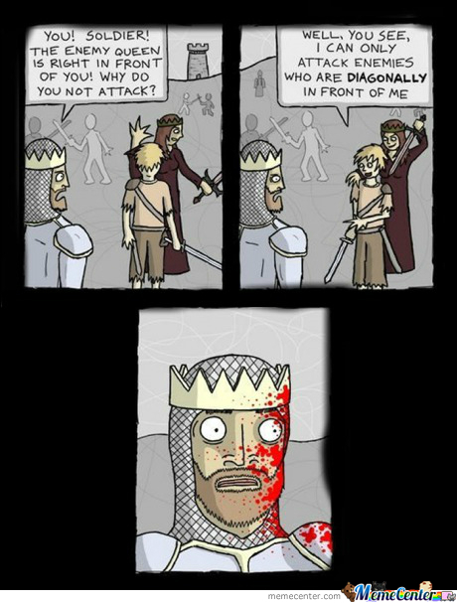
A little about Euler’s Eureka
Able to search 0.8 – 1.3 million nodes per second in the arena
Able to search 2.5 – 4 million nodes per second on a stock i7-4790k
Easily searches to at least depth 8 or 9
Meticulously crafted through roughly 200 hours of research, work, and benchmarking.
Uses bitboards
Written in C++11
Notes:
Second place’s engine, Neurochess, claimed to only be searching to depth 6.

Slide 3
Search algorithm Enhancements
Transposition Tables
Stores best move and best score found at entry, and if it failed high/low
Using hand written hash table for fast look ups, as vast majority of entries will never be used, and majority of requests will not be found.
Sped up search by 70-85% (determined from setting table size to 1)
MTD-f (Memory-enhanced Test Driver)
Basically performs a binary search into the alpha beta tree with zero width windows (beta = alpha+1)
Sped up search again by another 20-40%
Quiescence search
Searches all captures, checks, promotions, and all moves while in check.
Limiting quiescence search depth to 14 (to kill perpetual checks)
entry &operator[](const uint64_t zobristHash) { return hashTable[zobristHash % tableLength];
}
Notes:
I encourage researching the polyglot “.bin” file format of opening tables before implementing transposition tables
-http://hardy.uhasselt.be/Toga/book_format.html
Careful with how you set up entries in transposition table, simply changing the order of variables in a struct can increase/decrease its memory footprint. (learn how memory is aligned)
.

Slide 4

Move ordering
Bits of packed move
0 - 5 : from square
8 - 13 : to square
16-18 : piece type moved
000=none (illegal)
001=king 010=pawn 011=bishop 100=knight 101=rook 110=queen
19 : double pawn forward flag
20 : queen side castle flag
21 : king side castle flag
22 : checking flag, will put opponent in check
23-25 : capture type (stores each type of piece:
bits 23-25 are 000=none 010=pawn 011=bishop 100=knight 101=rook 110=queen
26 : en passant flag
27 : equal capture flag, capturing same piece
28-30 : promotion type
bits 28-30 are 000=none 011=bishop 100=knight 101=rook 110=queen
31 : winning capture flag, capture is of a higher value piece
unused bits: 14-15
*bits 6 and 7 are used, but are not yet set during move ordering
**extends to 64 bits when history table enabled, and puts history values in the upper 32 bits
***using simplified definitions of winning/equal captures
Moves are bit packed into a single uint32_t
By carefully specifying which bits are set, a large amount of information is conveyed during sorting through a single integer comparison operation.
Entry from Transposition Table performed first.
Using std::make_heap with std::pop_heap after each move over using std::sort
~10-15% speed up
Puts off as much work to after a prune
Notes:
Recently found out rebel engine uses a simialer move ordering, http://rebel13.nl/rebel13/blog/lmr.html
I have my history table disabled as it appeared to hurt performance by about 5%, I would have turned it back on if I ever implemented late move reductions

Slide 5

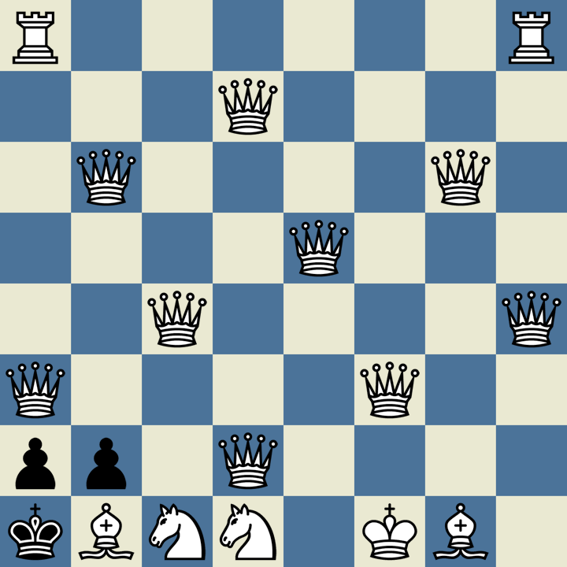
Move Generation
Creates only legal moves, to avoid performing an illegal move and needing to backtrack.
Move[218] over vector<Move>
Array is declared on the stack, while vectors allocate onto the heap
Sped up my move gen by 50-70%
218 is the maximum possible branching factor
Bit packing Moves into 4 bytes.
Transition from 24 byte moves to 4 bytes sped up my move gen again by ~40% despite extra work to pack bits
Notes:
Although more work is done to bit pack, I believe the performance improvement is likely caused by cache locality.
Additionally I use magic tables, for bishop and rook move generation.

Slide 6
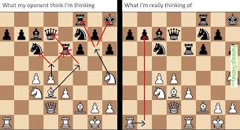
Time Management
Sets a minimum depth to search to based on time remaining.
Will use cutoff of 1/25th – 1/50th of time remaining, based on time remaining.
Attempts to predict how long the next iteration will take by predicting effective branching factor of current iteration and multiplying with time taken by current iteration. Stopping if time used will exceed cutoff
Uses two metrics to determine effective branching factor and averages
Ratio of current iterations time elapsed with previous iterations time
log_{depthSearched}(nodesExplored)
Notes:
Careful with pondering, as it can confuse my time management algorithms, causing it to believe another iteration will take much shorter than it really will. I ended up turning my pondering off due to this.

Slide 7
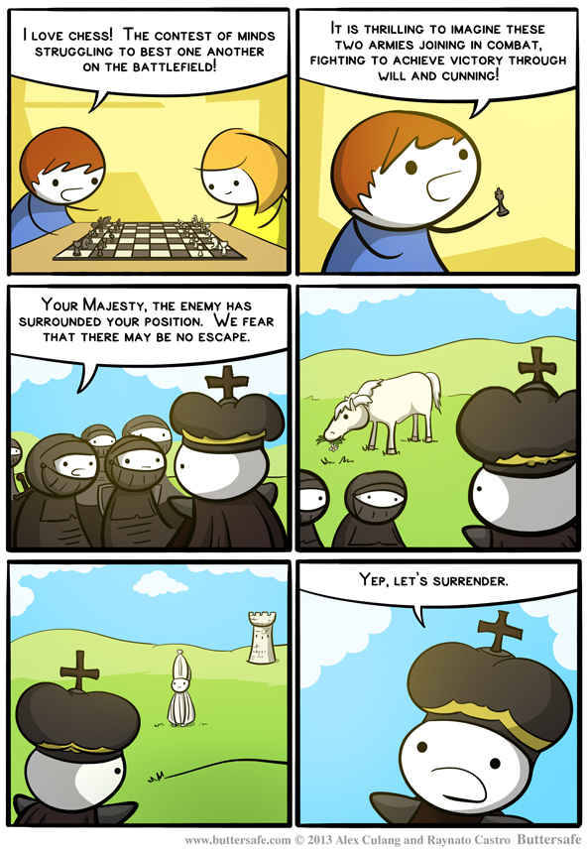
State Evaluation
Material Balance
Pawns=1, knights=3, bishops=3.5, rooks=5, queens=9
Bonus to pawns protect by other pawns
Bonus to passed pawns by square of distance travelled
King tropism
Bonus to castling, punish for losing ability to castle
Punish having not yet moved minor pieces out of back rank
Notes:
In terms of state evaluation research, big thanks to:
https://books.google.com/books?id=9-3pBwAAQBAJ&pg=PA97&lpg=PA97&dq=chess+%22king+tropism%22&source=bl&ots=5iDJCFlOOd&sig=or7k6qk6h-YYrdBy4WFfWVPy70Y&hl=en&sa=X&ved=0ahUKEwir34iyq6DTAhWF64MKHel4AiAQ6AEIPzAD#v=onepage&q=chess%20%22king%20tropism%22&f=false
https://www.gamedev.net/resources/_/technical/artificial-intelligence/chess-programming-part-vi-evaluation-functions-r1208

